Slide 1
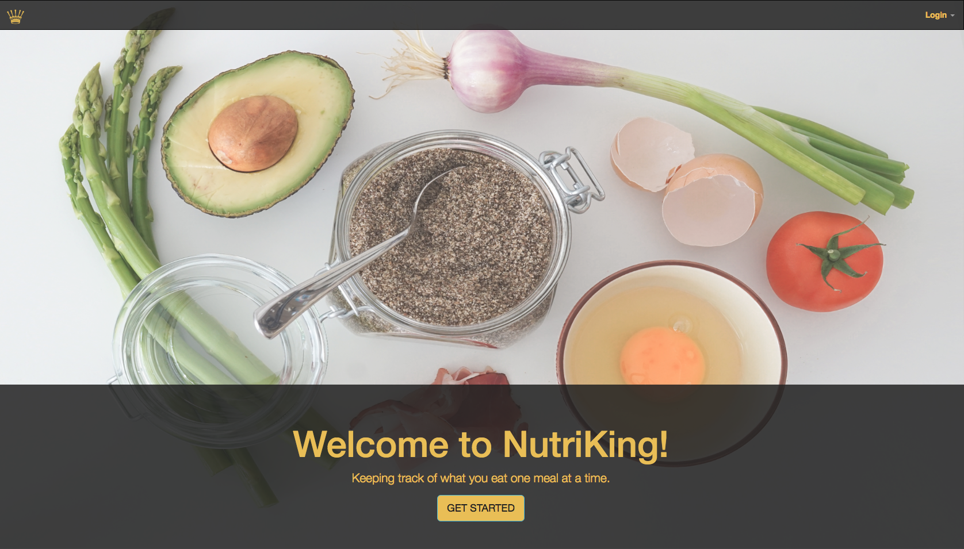

Slide 2
What is it?
An app that:
Allows users to log the food that they consume everyday including calories and nutrients
Allows users to see a summary of their daily intake of protein, carbs, and fats
Allows users to set a calorie consumption goal and check it against what they actually ate

Slide 3
Created by
Lawrence Gomez,
Shahrooz Hedayati,
Hines Kao

Slide 4

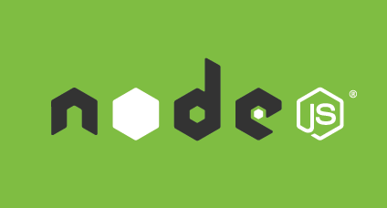



Technologies
Language: JavaScript, HTML, CSS
Framework: Node.js
Site Structures and Styling:

Slide 5



Technologies
Database: Mongo, mlab for deployment
Deployment: Heroku
Agile Development: Trello

Slide 6
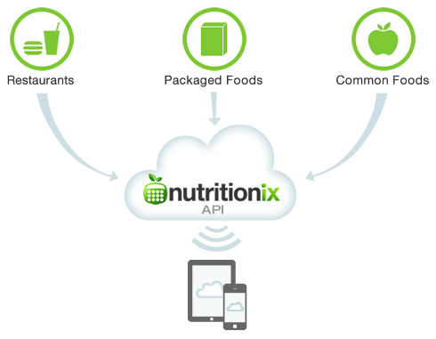
API
Nutritionix API
https://www.nutritionix/business/api
Database of nutrition info

Slide 7

Target User Base
Fitness motivated individuals that like to log the food they consume in order to meet their fitness goals
Weight conscious users that need to track daily food intake to monitor their weight

Slide 8
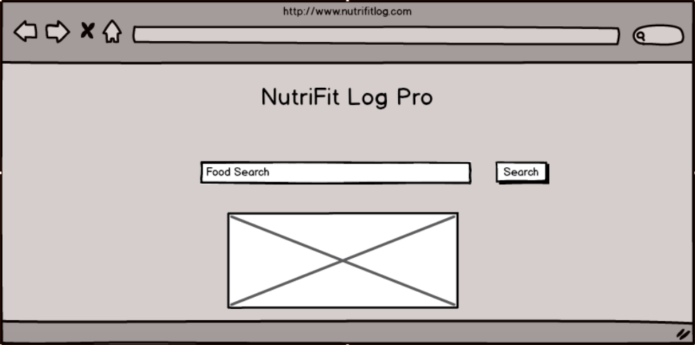
wireframe

Slide 9
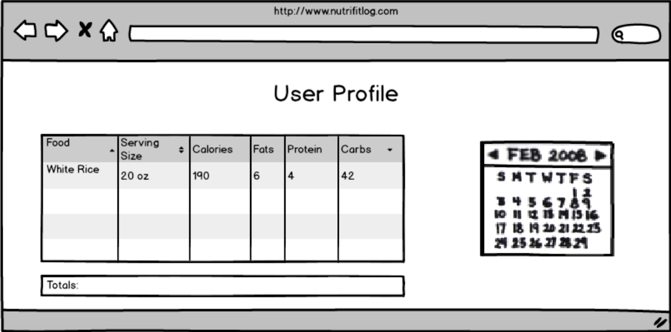
wireframe

Slide 10
Total adjustment of Market
Number of potential users = 244 million
Age of user: 18+
Price per download: Free
Total adjustment of market: 240 million

Slide 11
Plan of execution
Find a suitable API
Test API for functionality
Incorporate API into application
Launch

